Slide 1
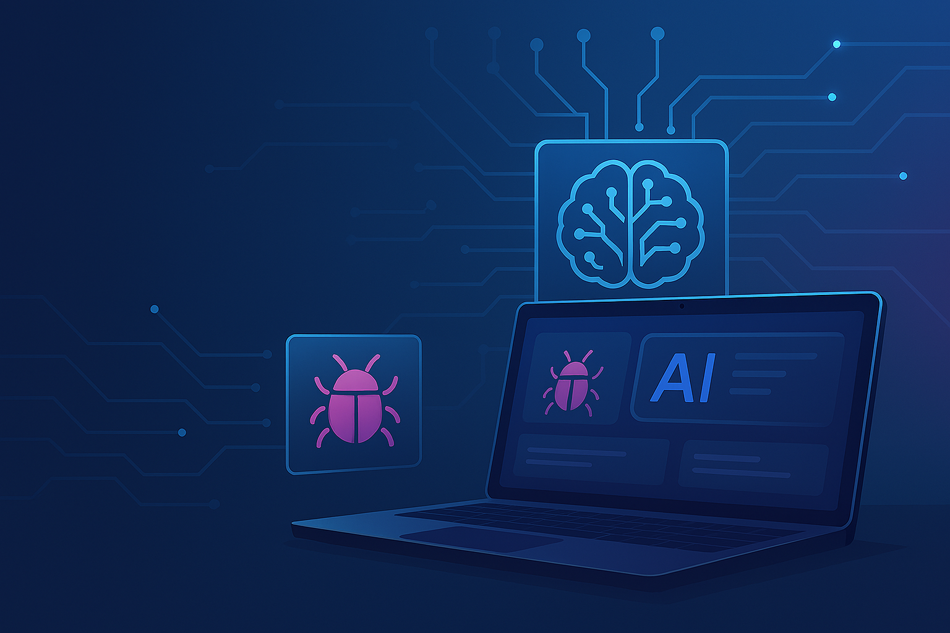
AI-Enhanced Bug Tracking Platform
Full-stack solution with React, Spring Boot, FastAPI & AI RAG integration
Divya sri vemula

Slide 2



The Problem & Our Solution
The Problem
Our Solution
Bug tracking is manual, repetitive, and lacks context. Developers waste valuable time:
An intelligent bug tracker that uses AI to augment the developer workflow. It provides:
•
Shifting through duplicate issues.
•
Smart suggestions for priority and resolution.
•
Manually prioritizing new tickets.
•
Real-time retrieval of similar, resolved issues.
•
Searching for resolutions to similar past bugs.
•
A smarter, context-aware bug creation process.

Slide 3
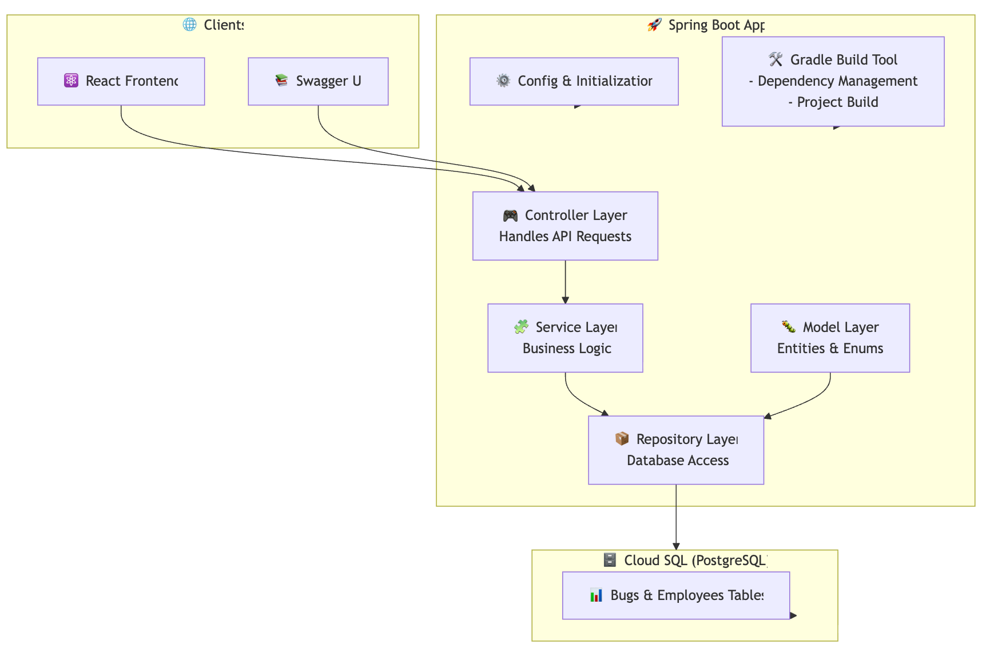
The Backend: Built with Spring Boot

Slide 4
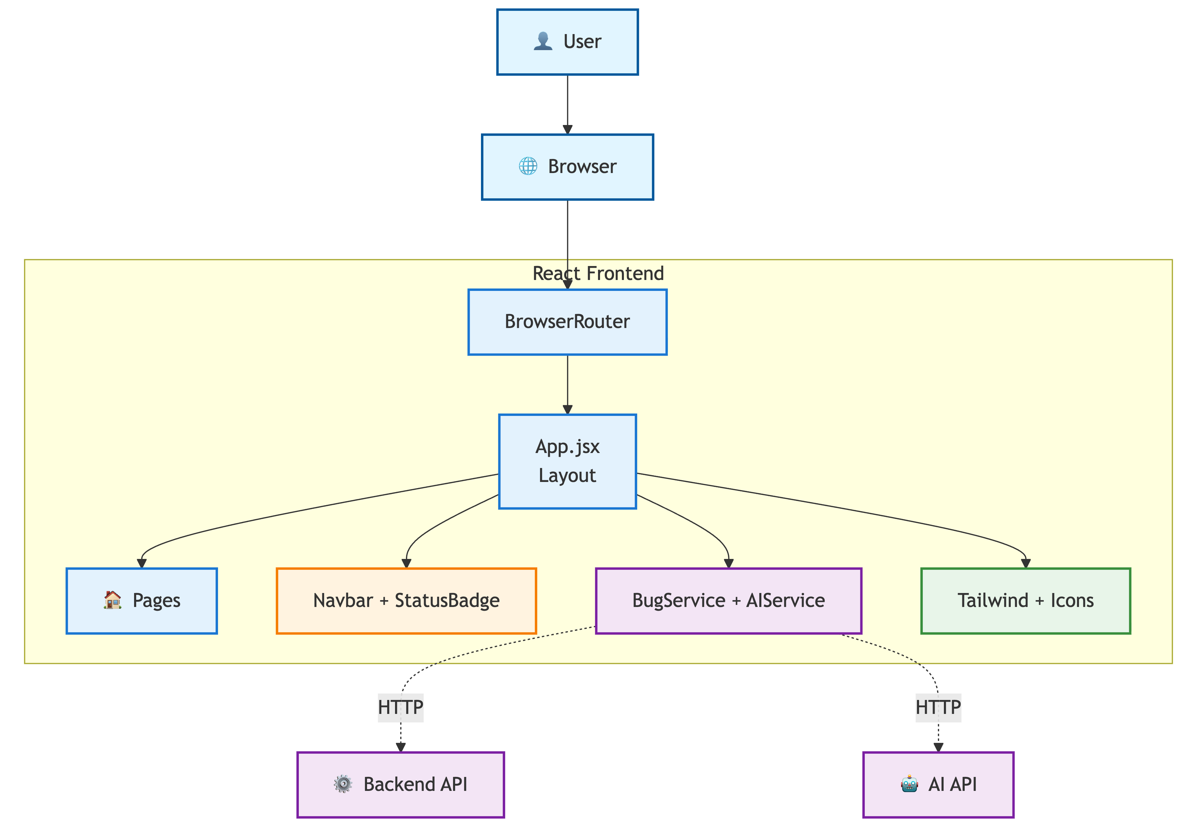

The Frontend: Built with React

Slide 5
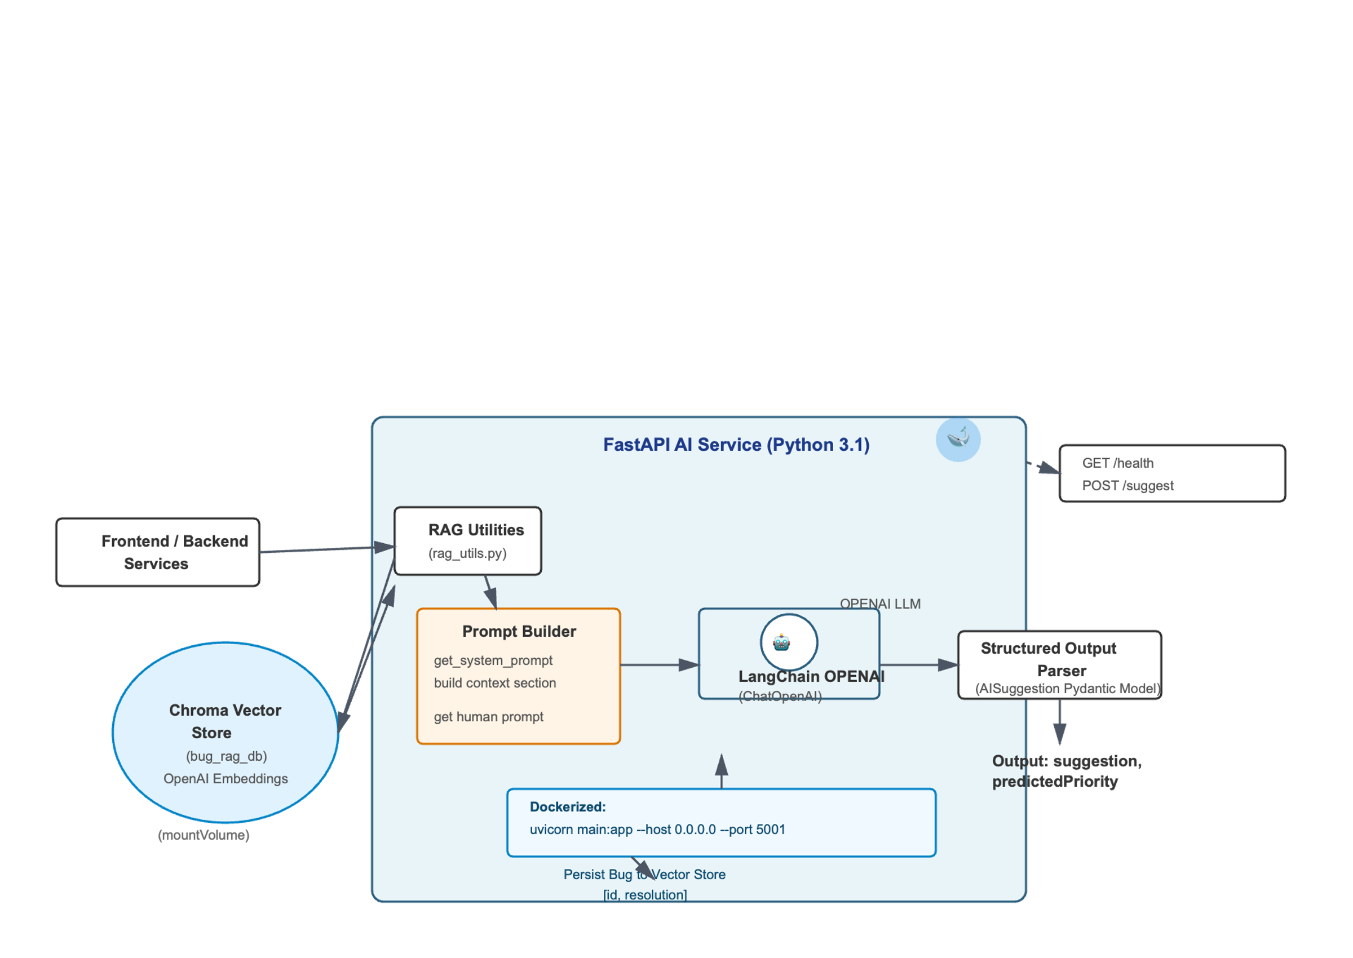
The "Magic": AI Service (FastAPI)

Slide 6

🧱 Infrastructure Setup
Terraform Scripts used to automate provisioning of:
Compute resources for backend & AI services
Secure networking and IAM configurations
Cloud SQL (PostgreSQL)
Containerization & Deployment
Application containerized using Docker
Deployed via Kubernetes YAML files for:
Pod configuration & scaling
Service exposure and ingress
Resource limits and health checks
☸️ Containerization & Deployment
Application containerized using Docker
Deployed via Kubernetes YAML files for:
Pod configuration & scaling
Service exposure and ingress
Resource limits and health checks

Slide 7
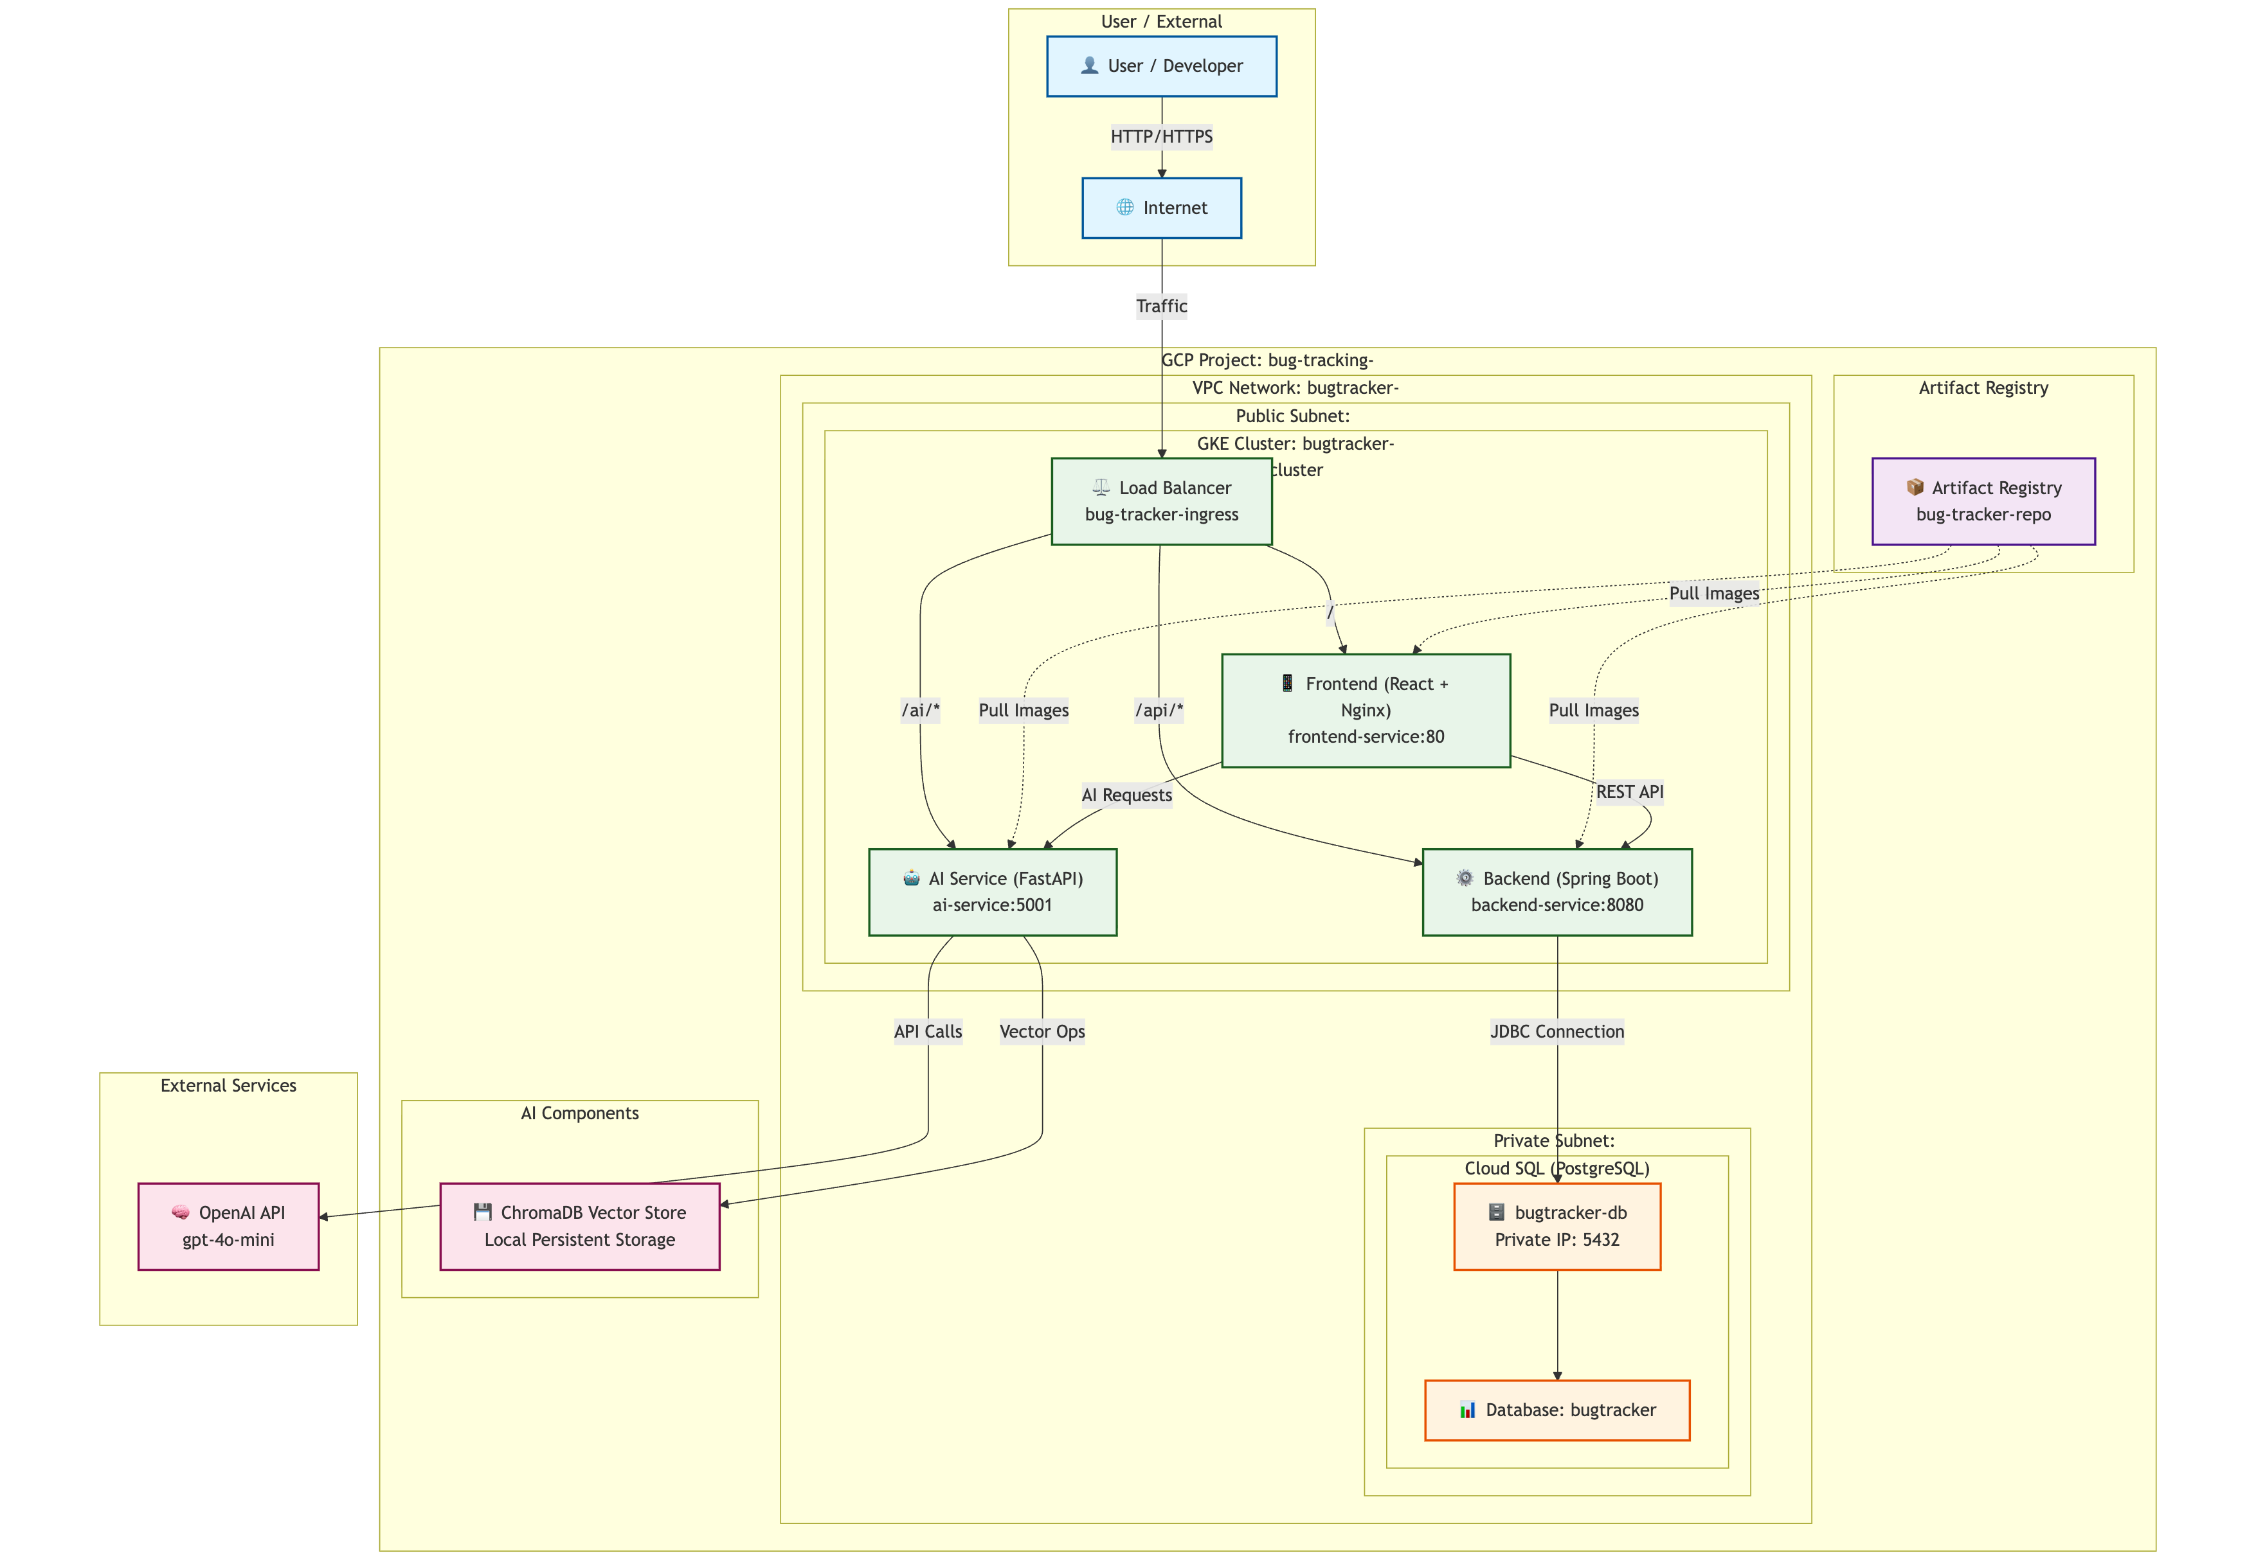
Full-Stack System Architecture

Slide 8
Connecting GCP to Databricks Medallion Lakehouse
Modern Data Engineering Architecture
Google Cloud
Storage
Databricks
Platform
Delta Lake
Format
Silver
Gold
Bronze
Raw Data
Ingestion Layer
Cleaned &
Validated Data
Business-Ready
Analytics
Data Engineering Architecture | 2024
1

Slide 9
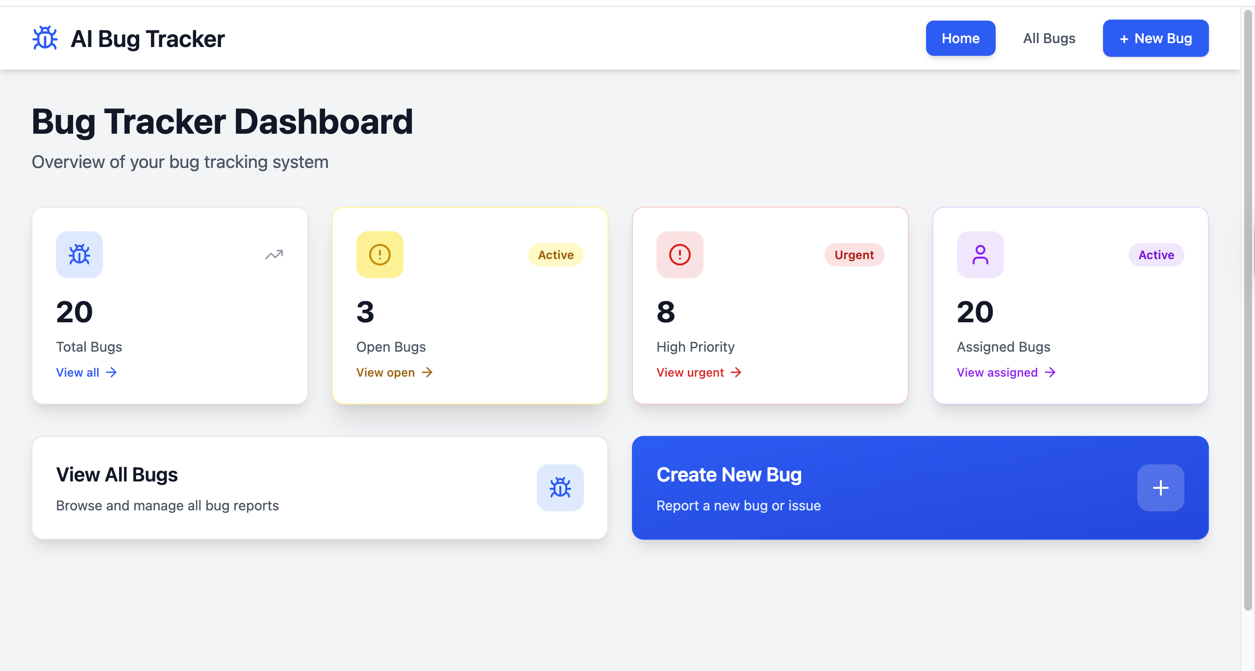
Application in Action

Slide 10
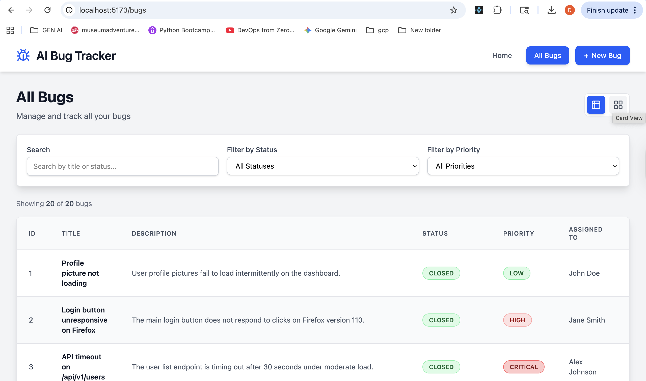
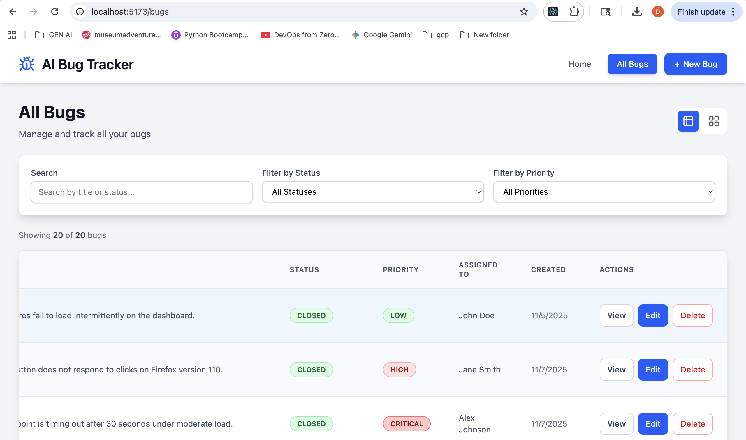
Application in Action

Slide 11
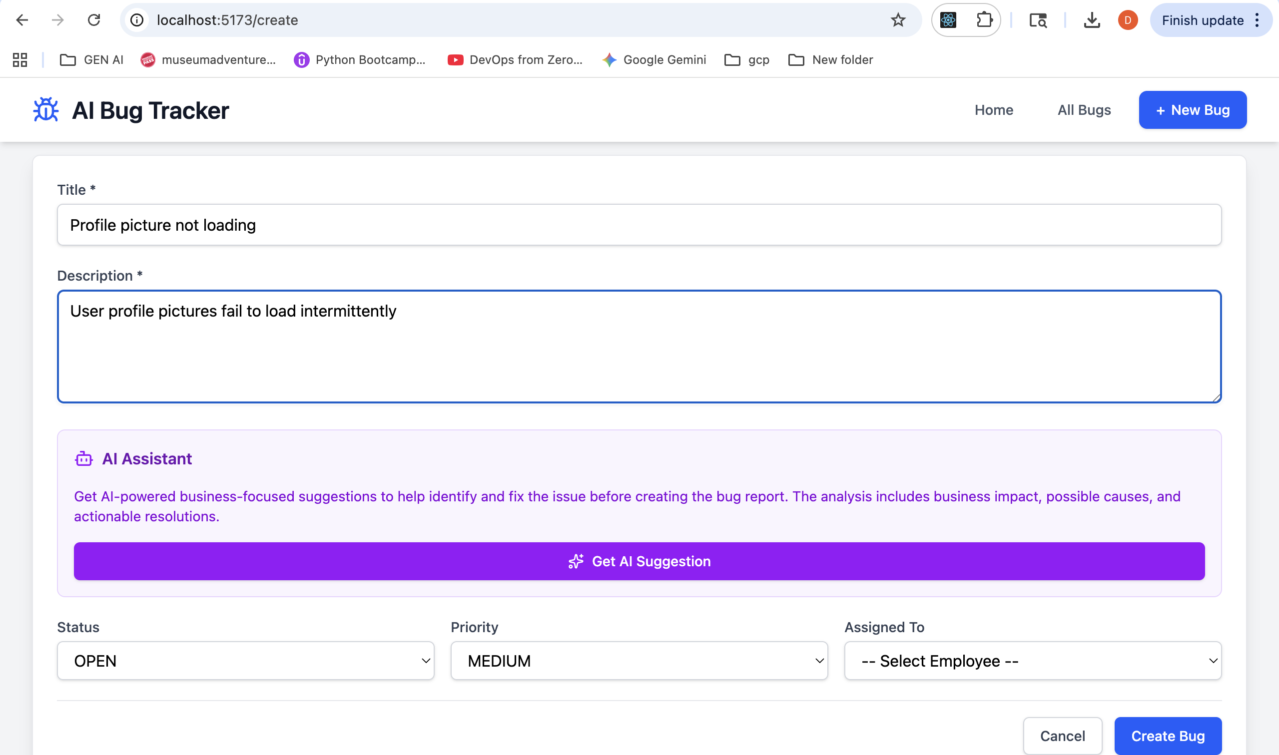
Application in Action

Slide 12
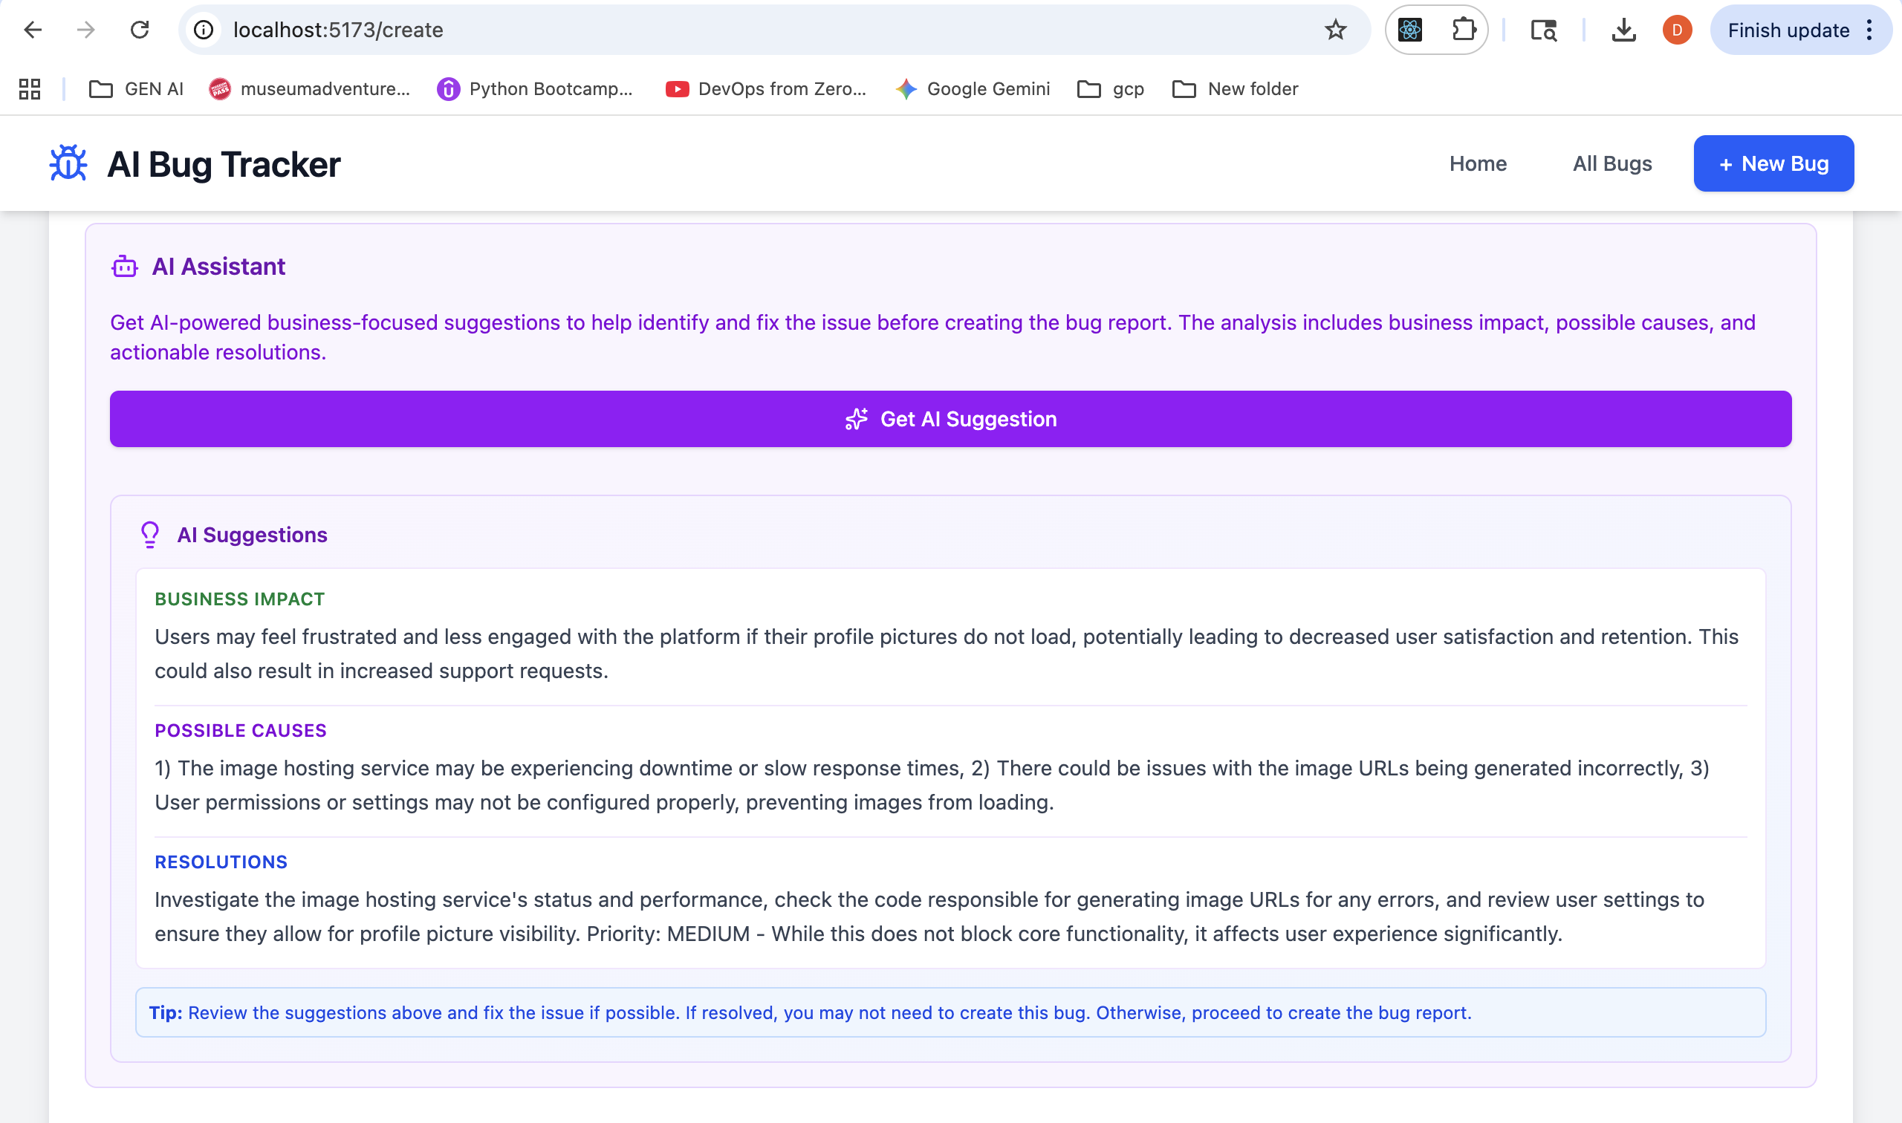
Application in Action

Slide 13
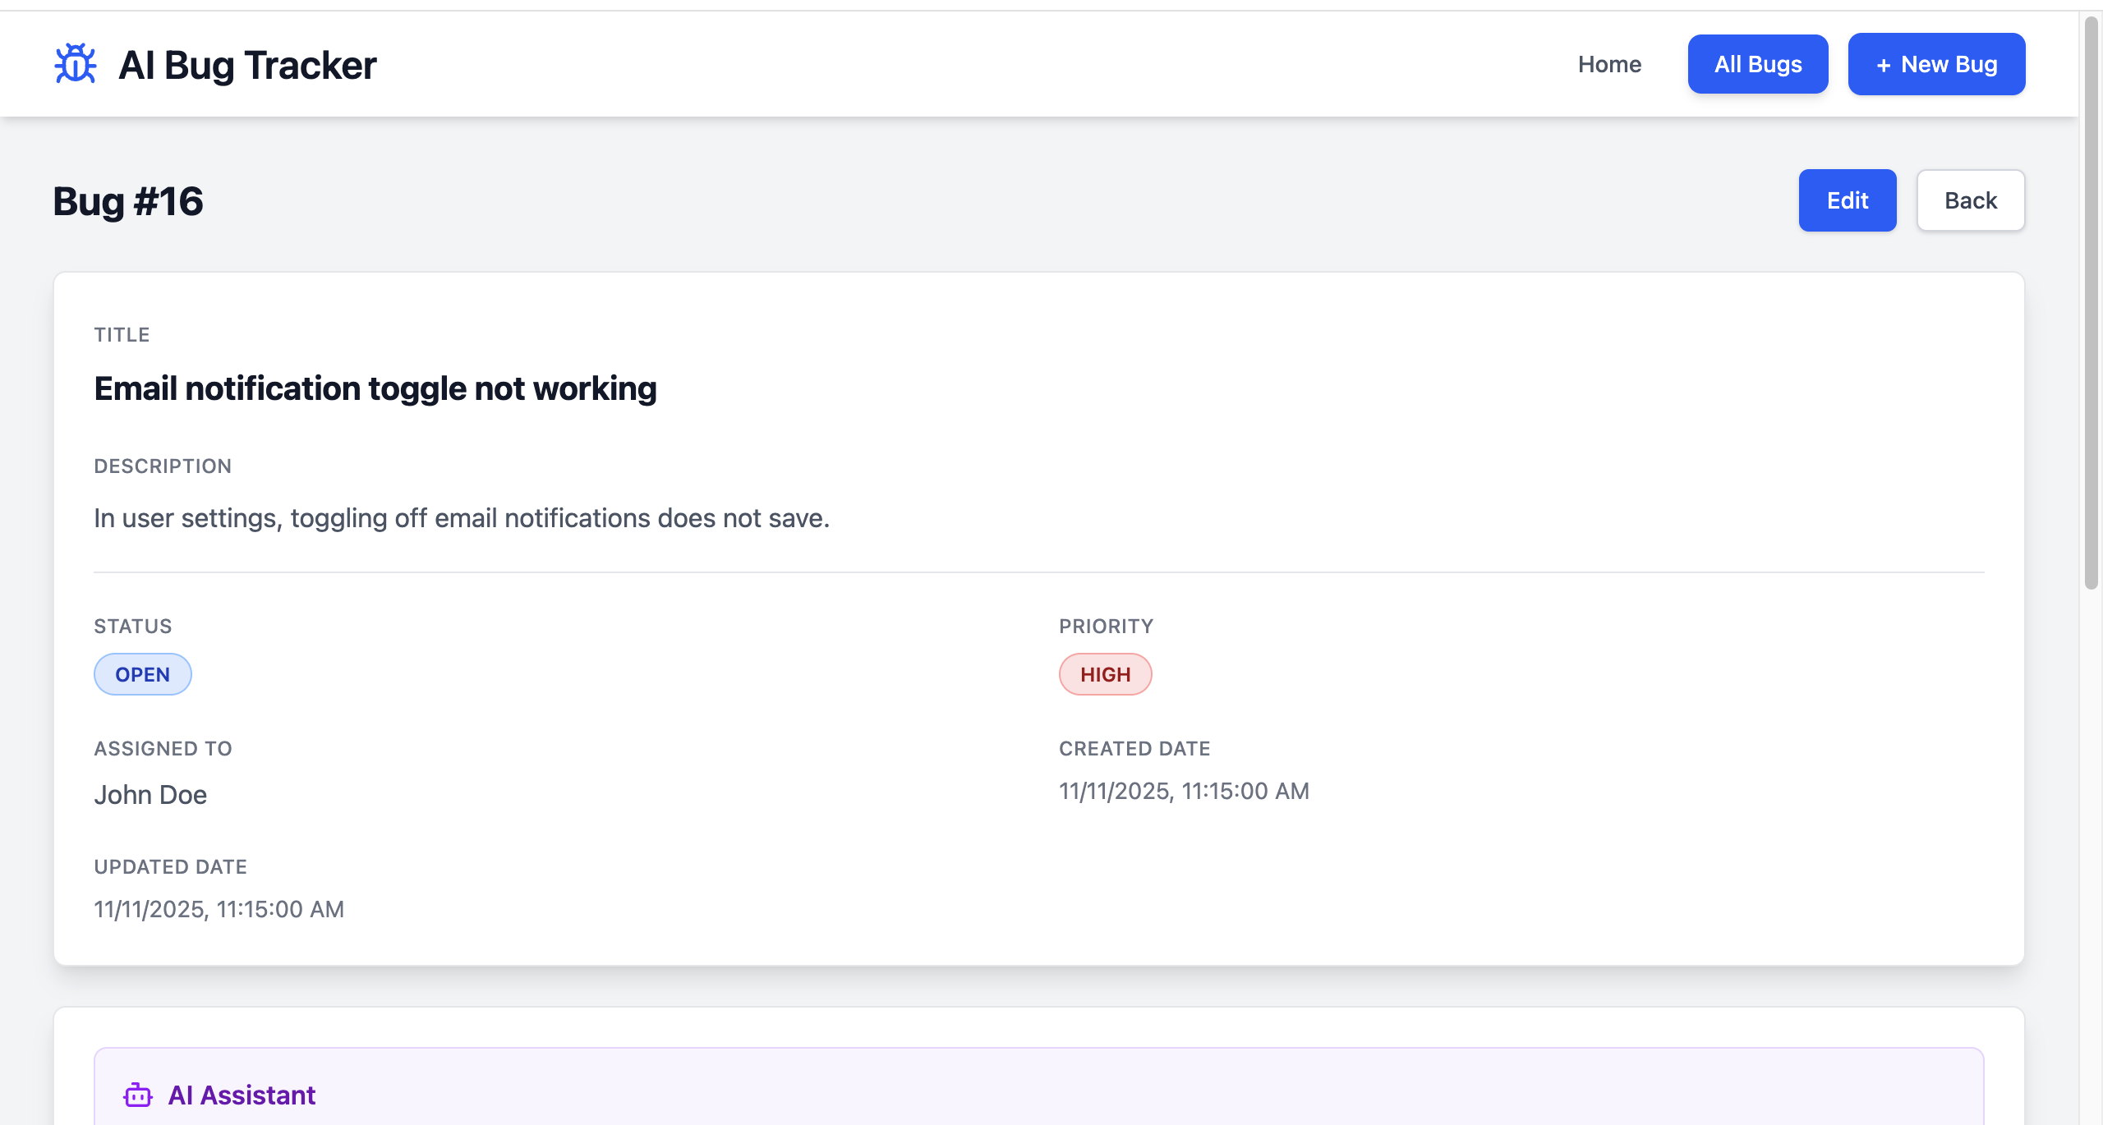
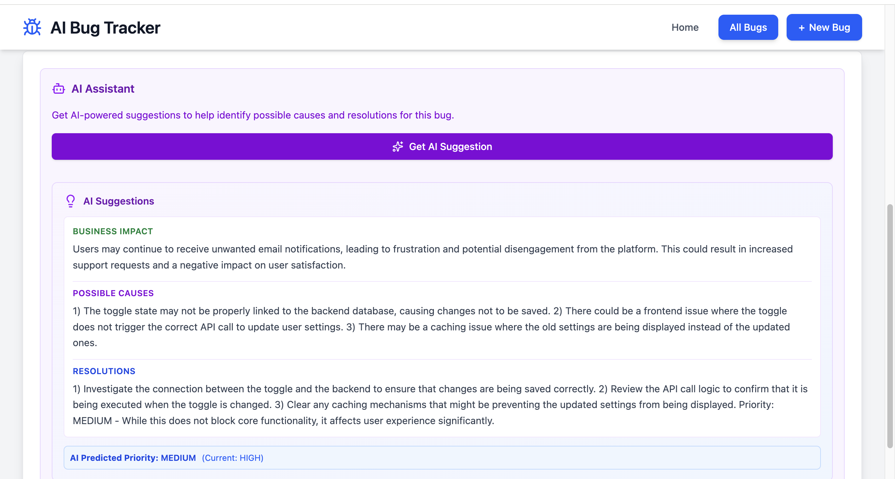
Application in Action

Slide 14
Questions?
Thank you for your time.

